Slide 1
Event Booking Website project

Slide 2
Presented by: Yousif Mahmoud Mohamed Debian : 12500123 Amr Sayed Mohamed Ali : 12500108 Ahmed Ashraf Fathy Khalil : 12500492 Mohamed Mostafa Mater Salem : 12500106 Dr : Mohammed AbdelFattah Dr : Esraa Dr : Rana

Slide 3
Project Description This project is an Event Booking Website designed to allow users to book seats for events easily through an online platform. The website provides a simple and clear interface where users can view event details, fill in a booking form, and select seats. All booking data is stored and managed through a connected database. The system also includes an admin panel that enables administrators to log in securely, view bookings, and manage stored information efficiently. Programming Languages and Technologies Used HTML for building the structure of all web pages. CSS for styling and improving the visual appearance. JavaScript for adding interactivity, especially seat selection. PHP (Backend) Technology for handling booking processes and admin authentication. Database for storing booking and admin data.

Slide 4
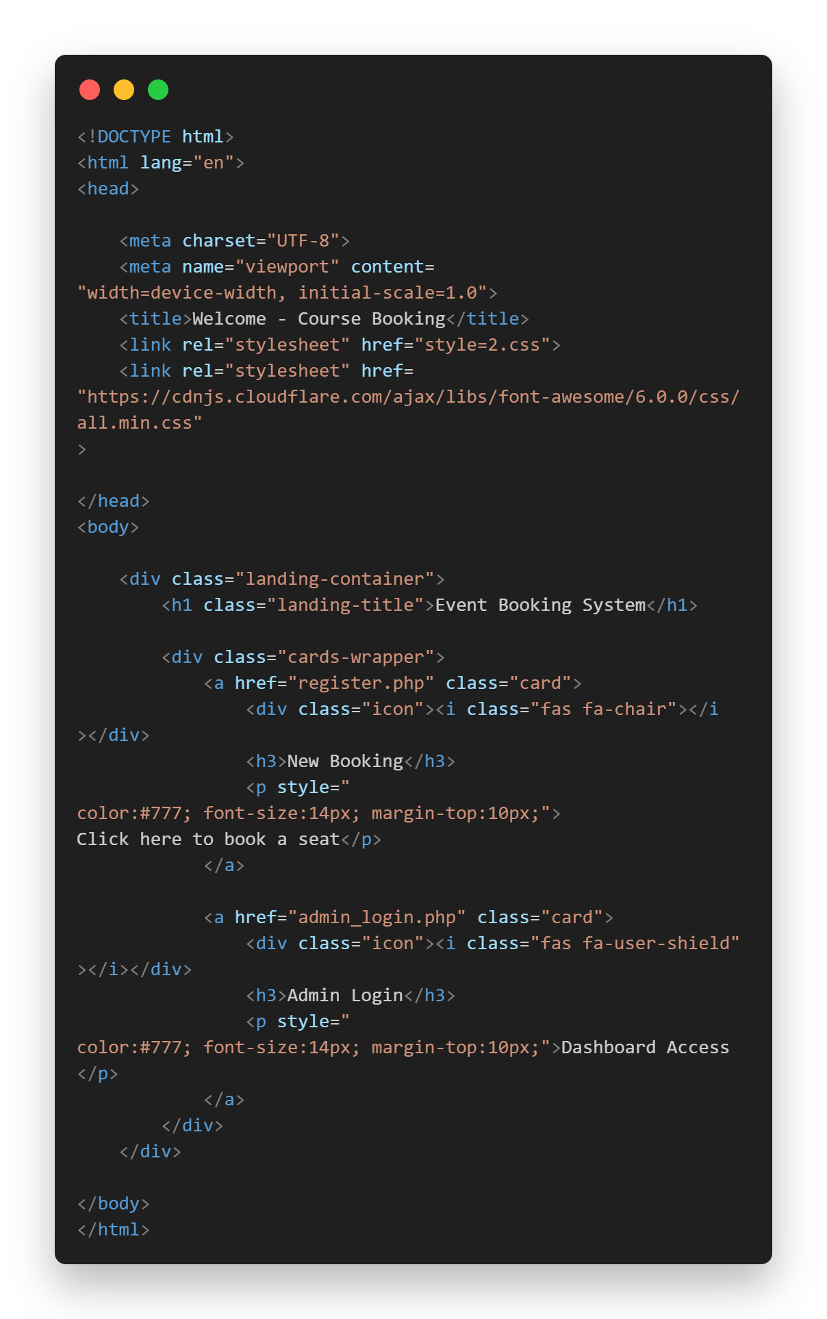
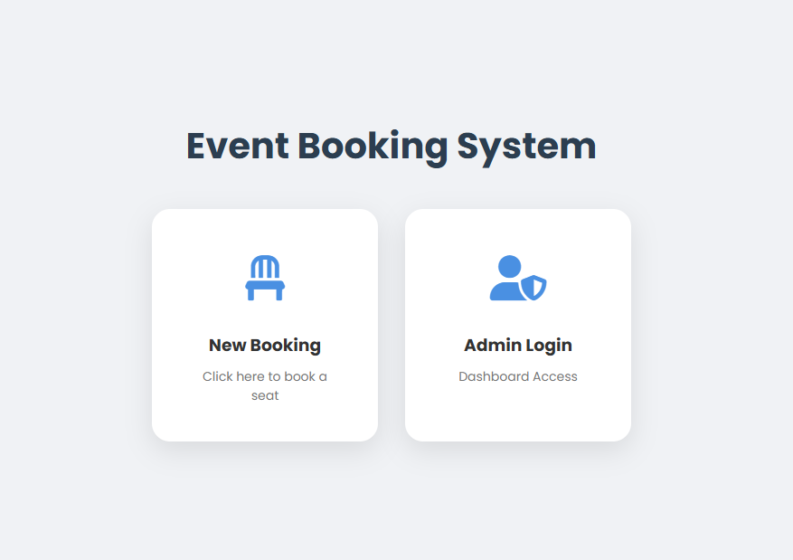
Description : Home page made by HTML
Home page code
Home page overview

Slide 5
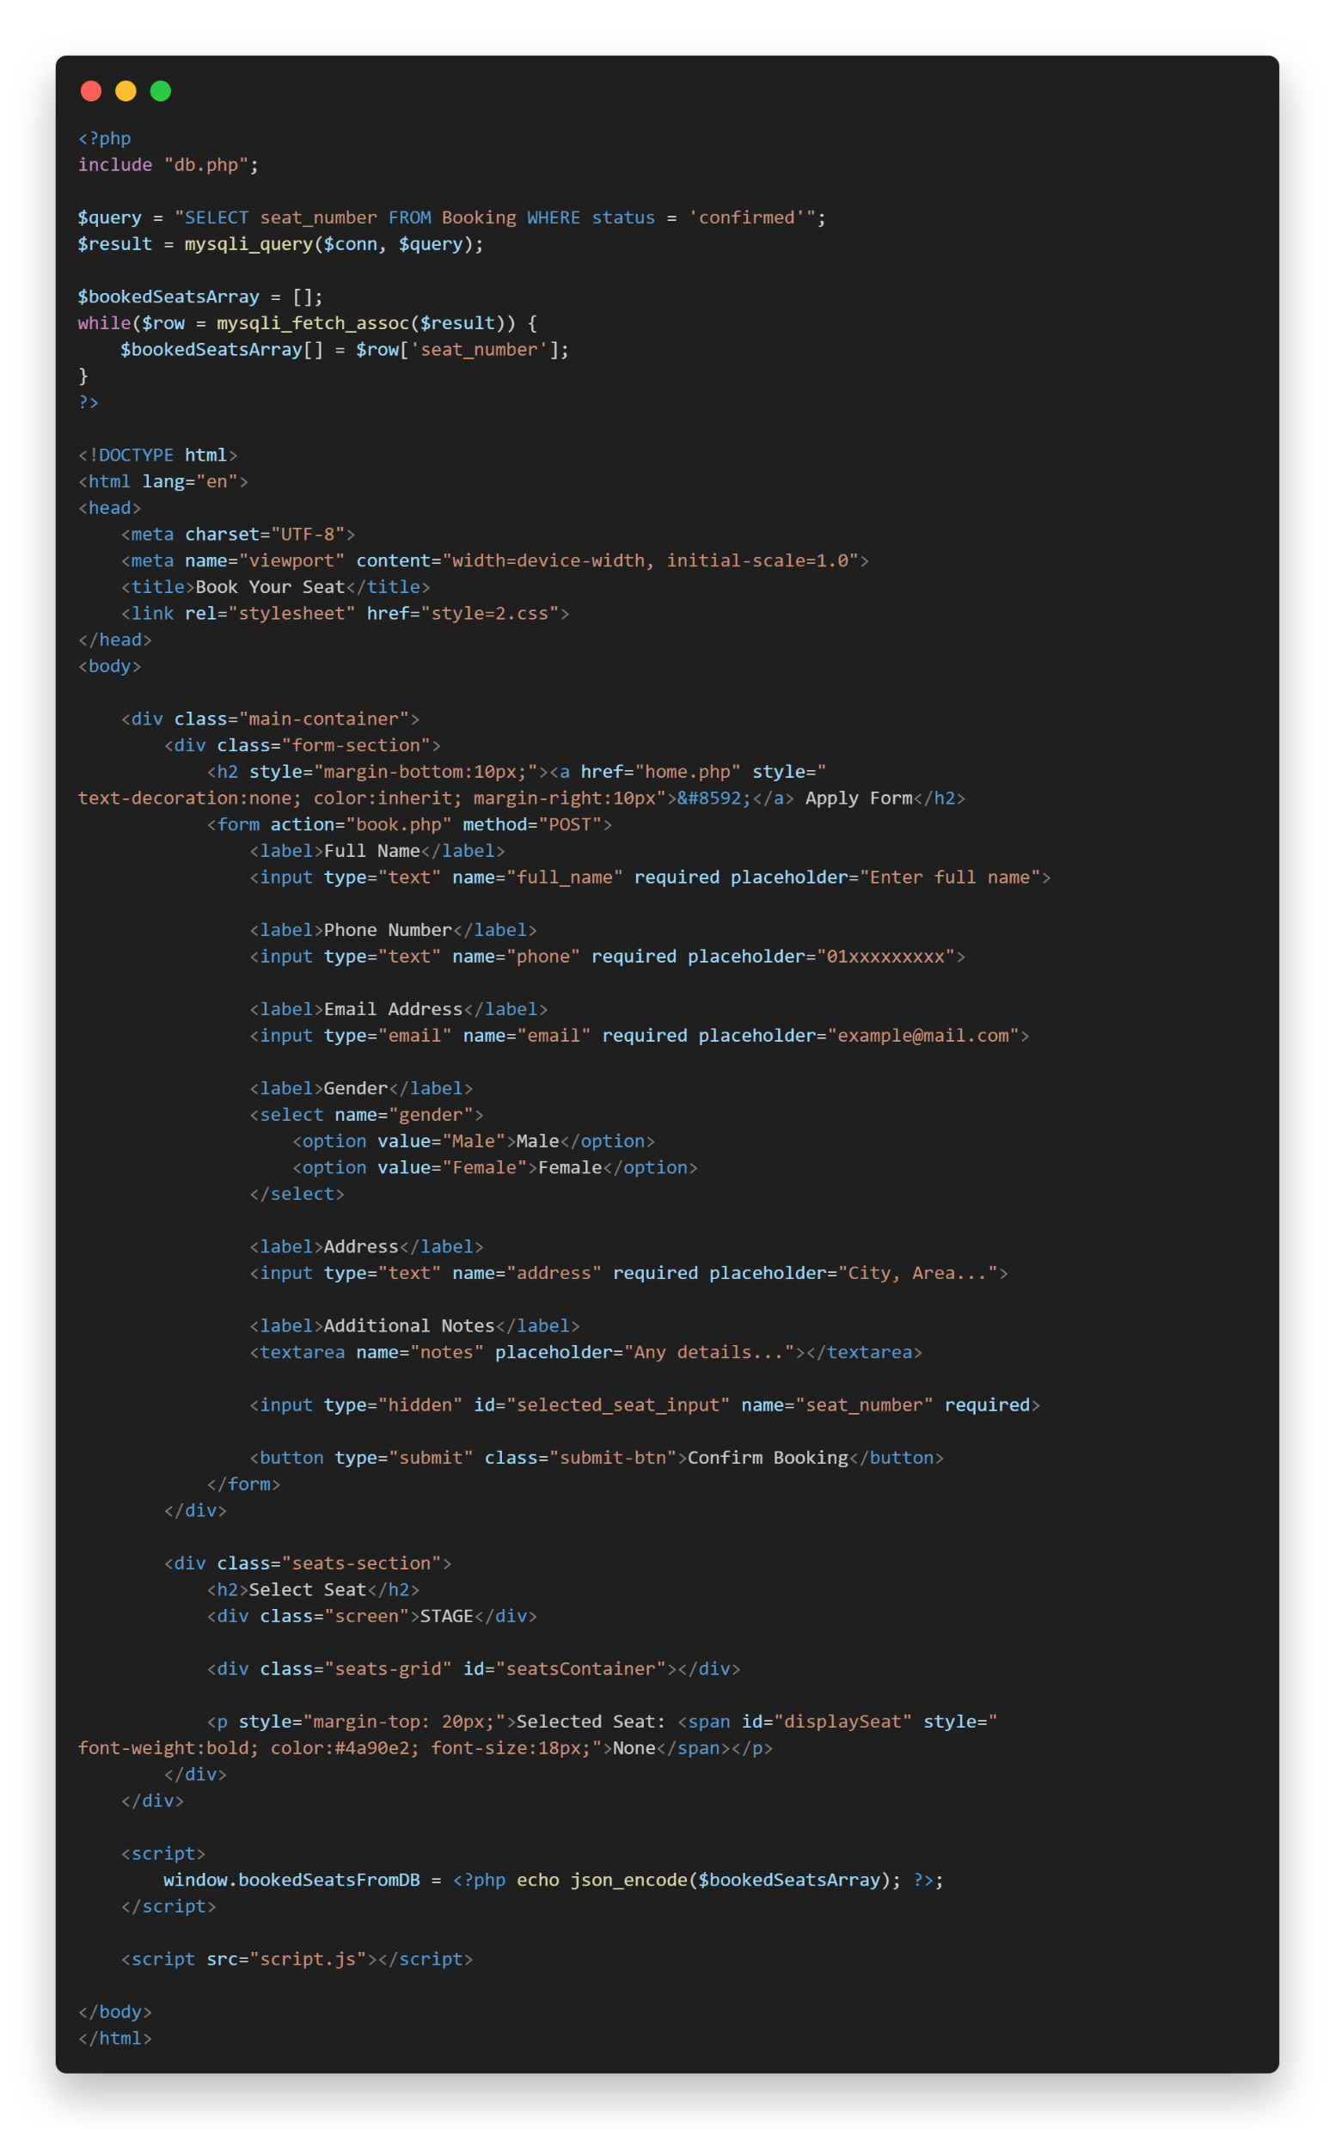
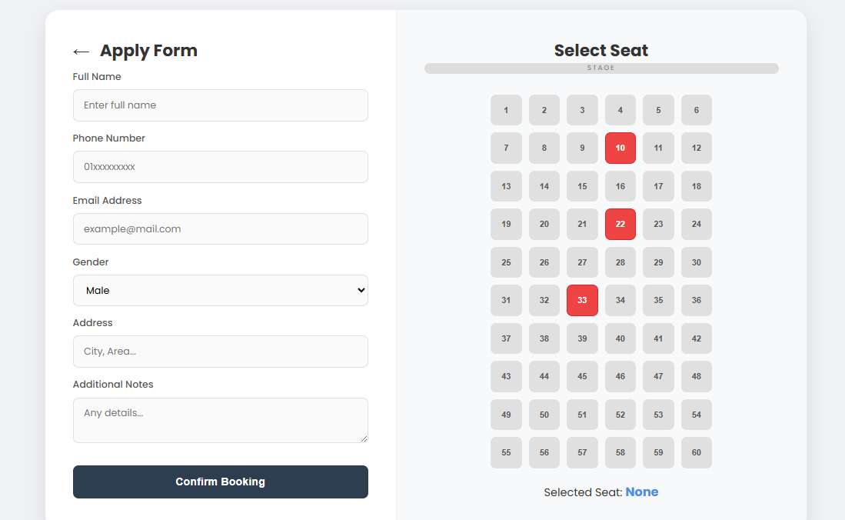
Description : Booking form made by HTML
Booking form
Booking code

Slide 6
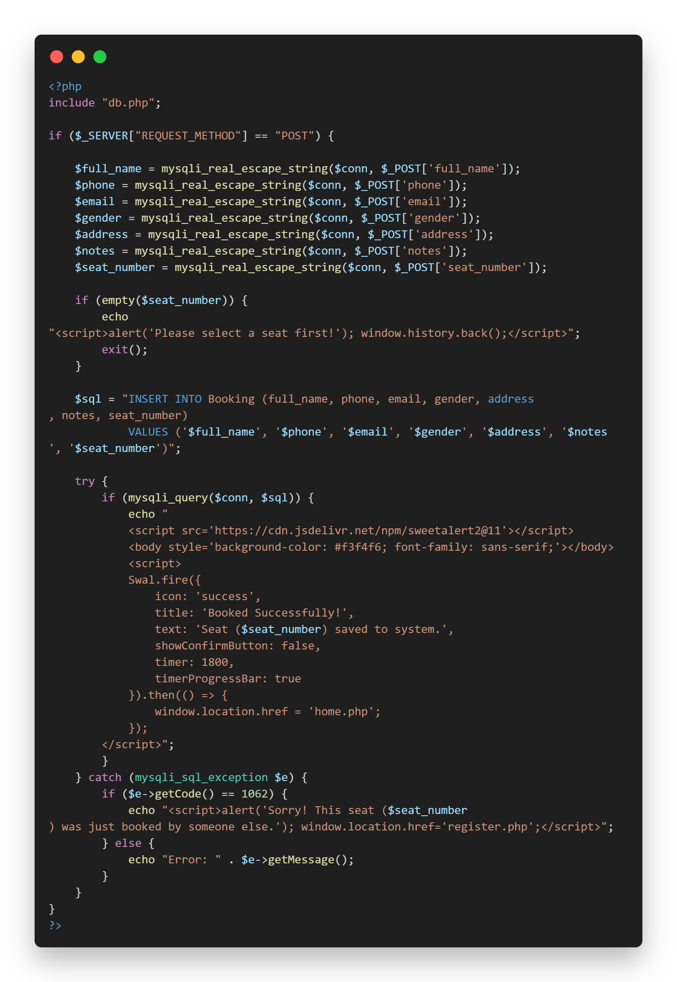
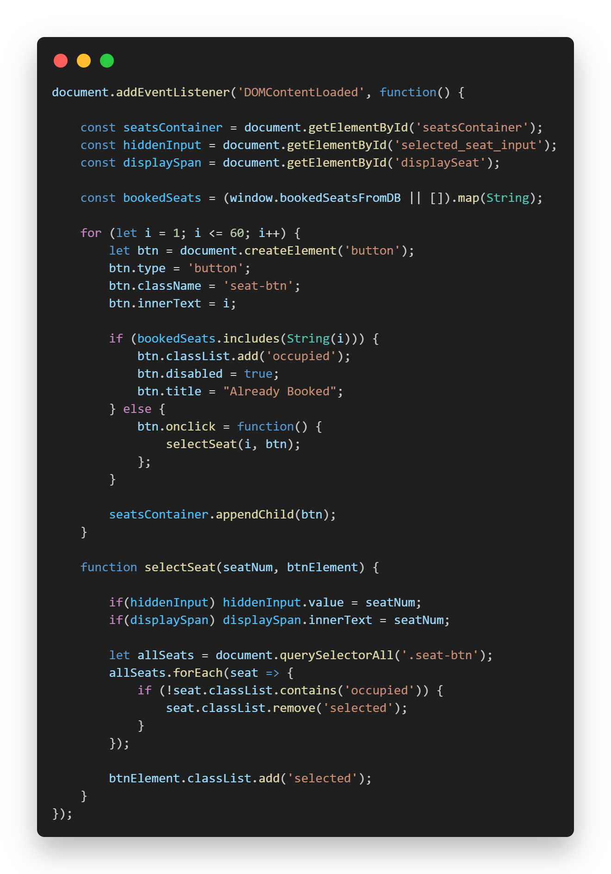
Booking Backend
Seat Selection JavaScript

Slide 7
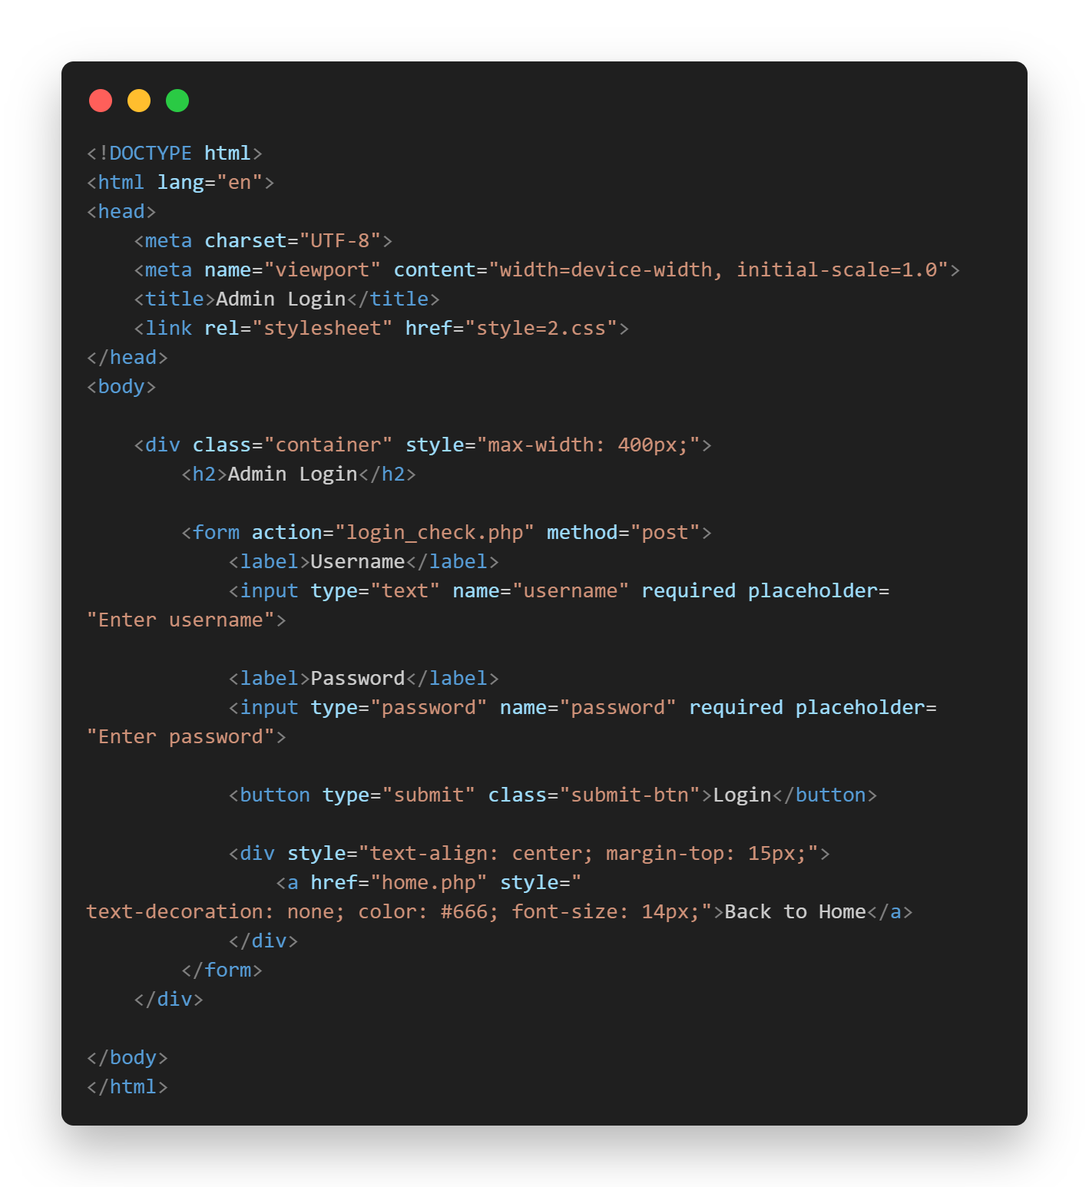
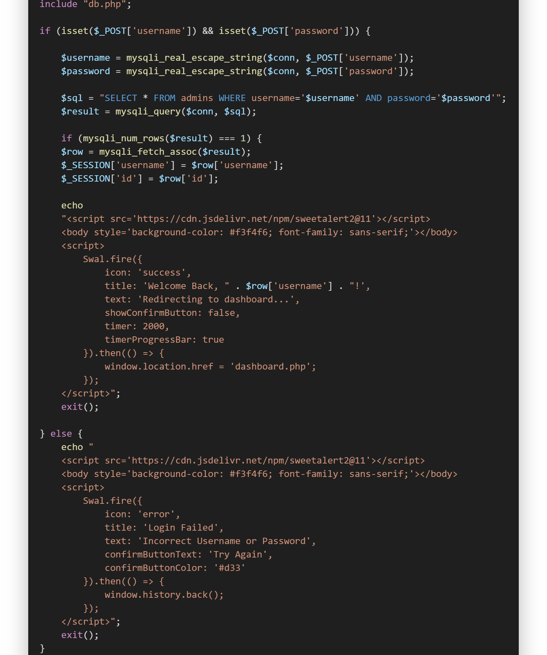
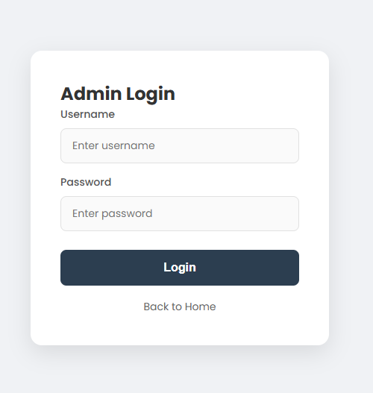
Description : Admin login page
Admin login
Admin login frontend code
Admin login backend code

Slide 8
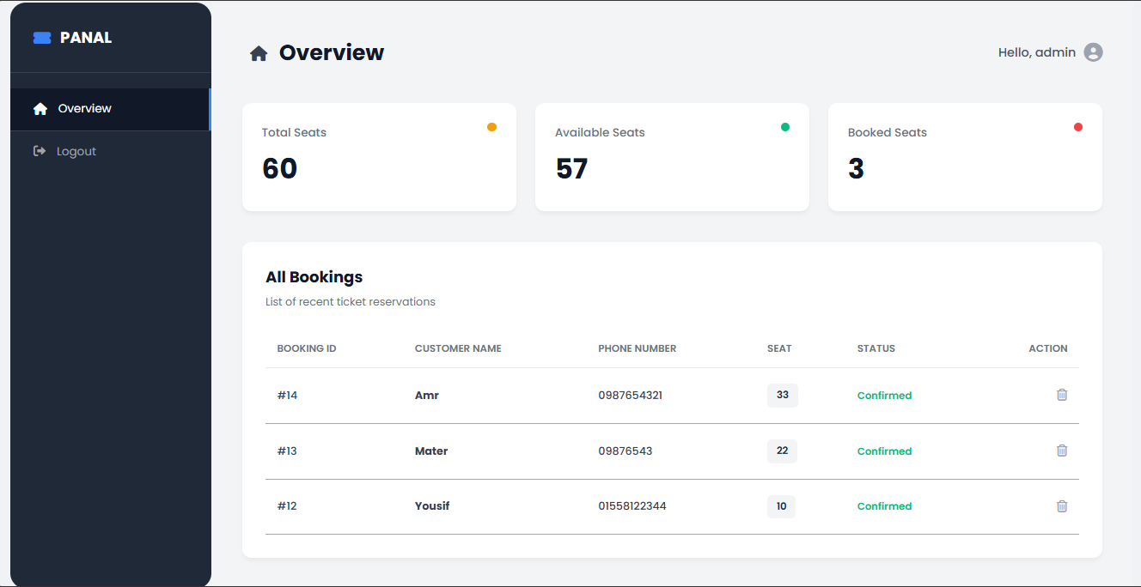
Description : Overview page
Dashboard page

Slide 9
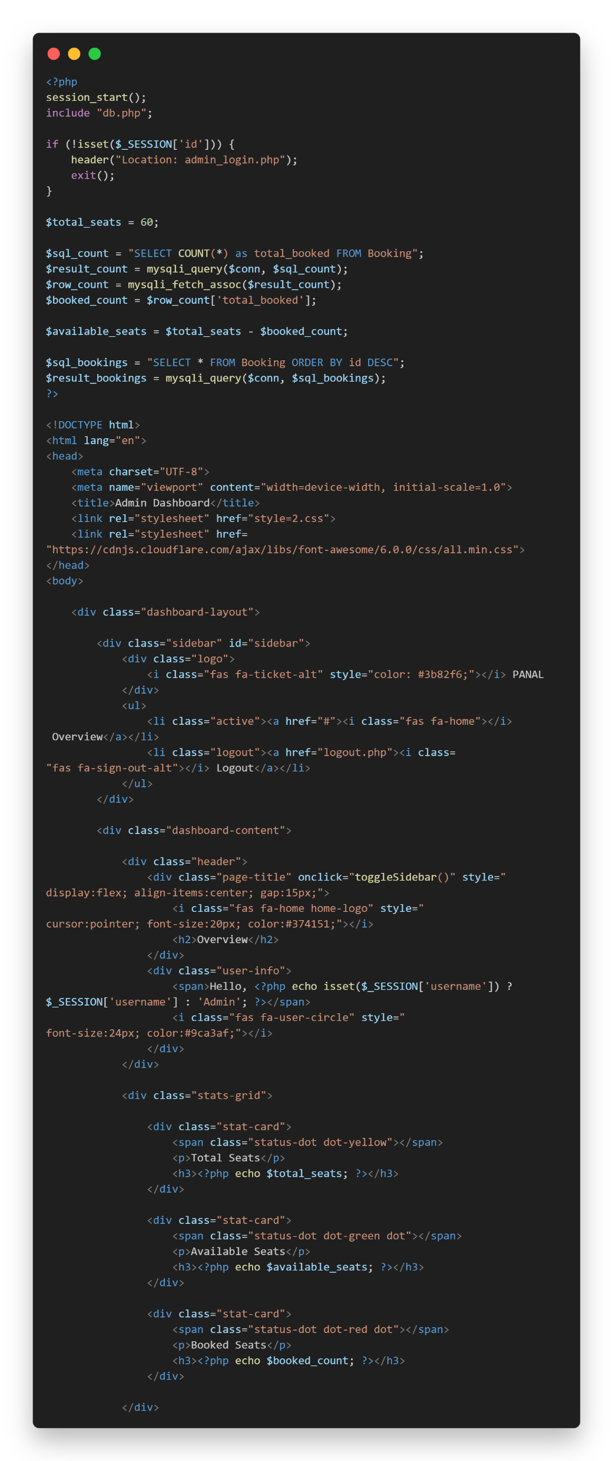
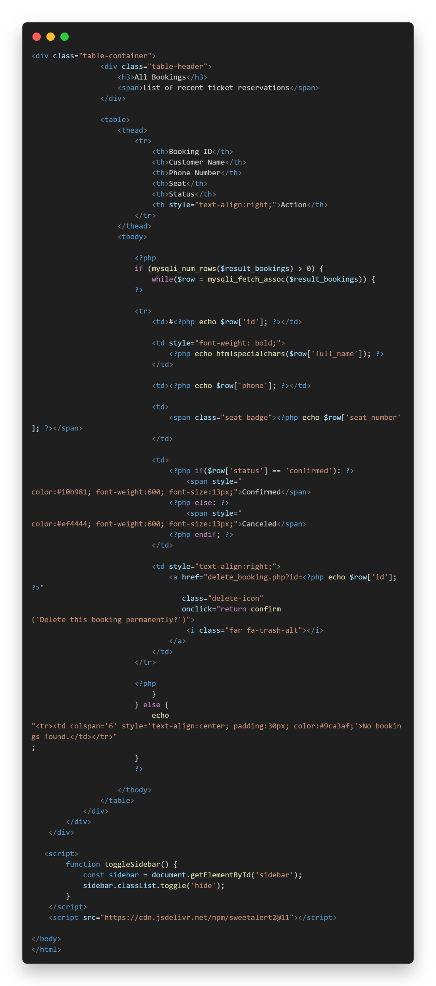
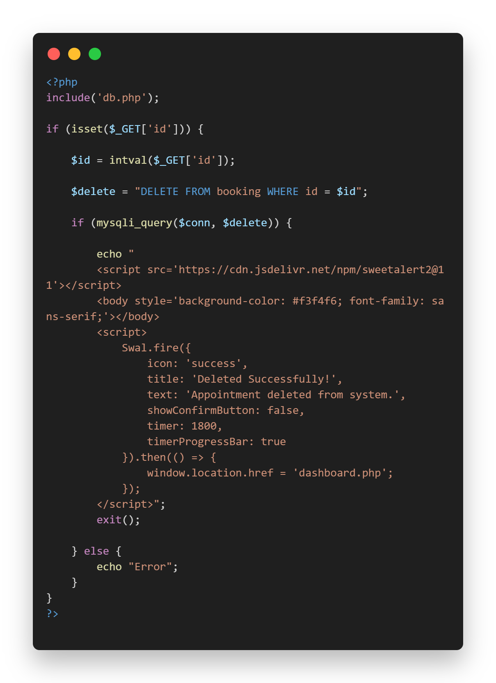
Dashboard page code
Delete button code

Slide 10
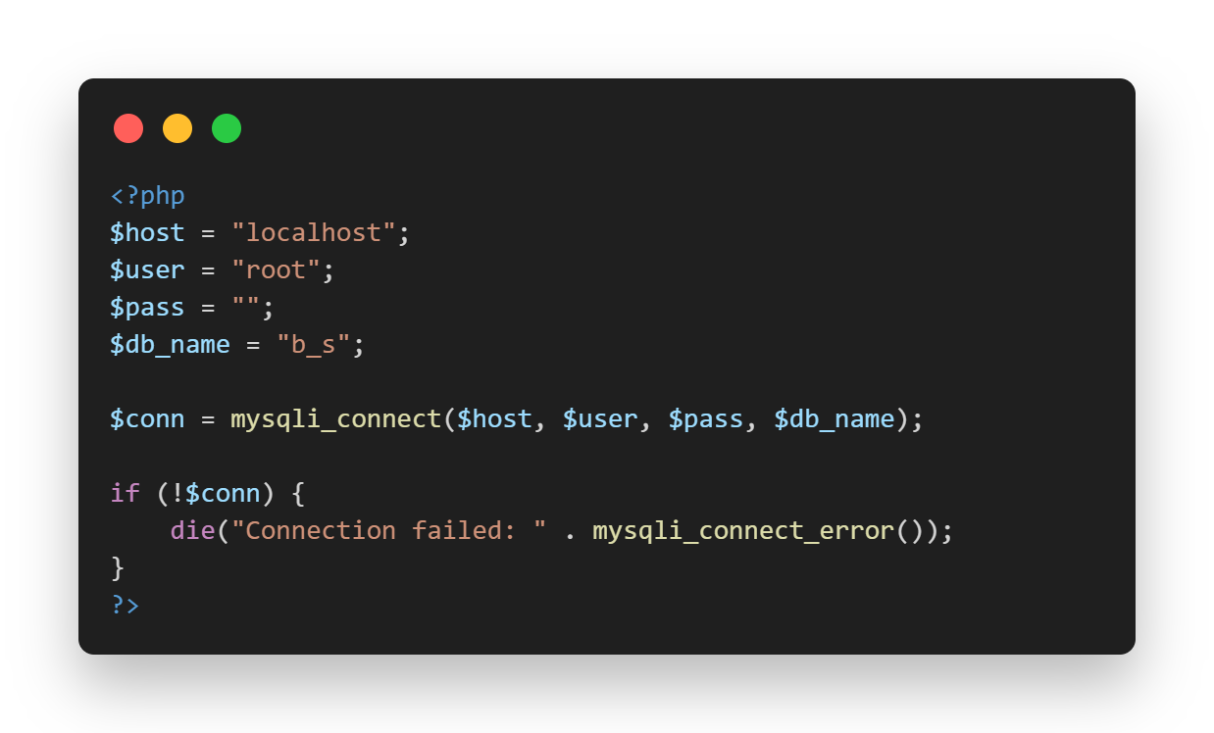
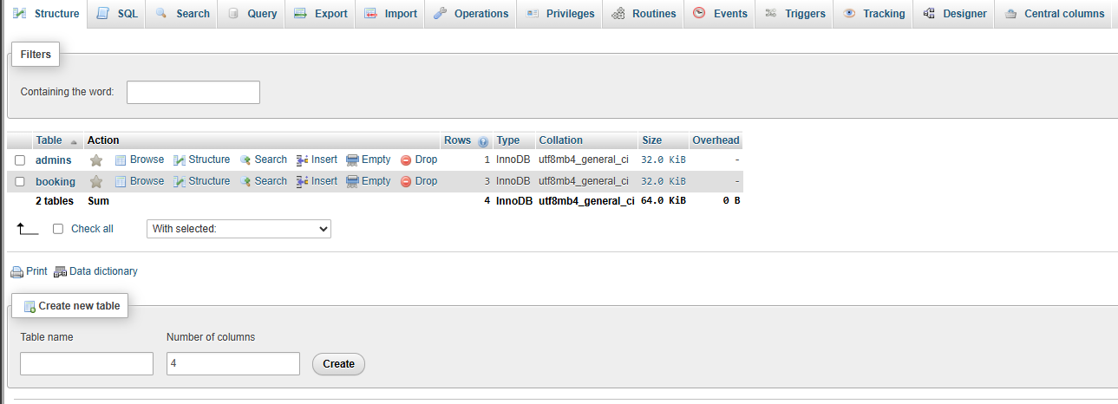
Connect to DB Code
Database

Slide 11
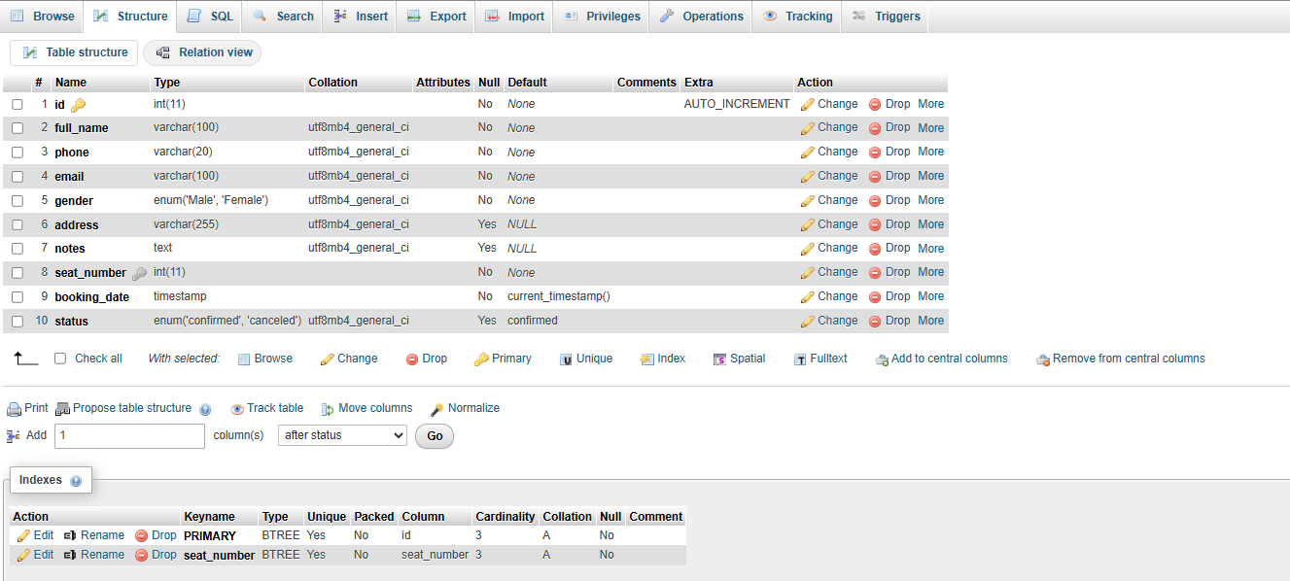
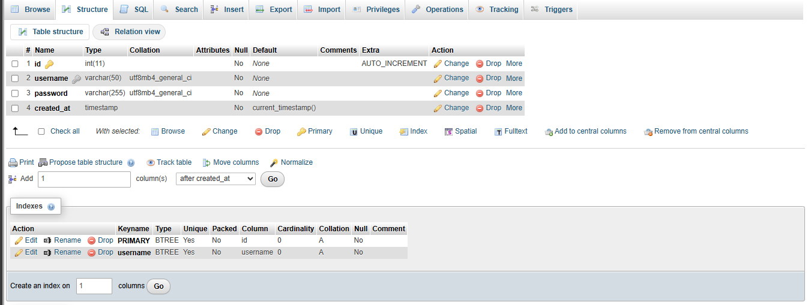
Booking Table
Admin Table

Slide 12
Thank You

